Slide 1
Upscaling Basic Sanitation for the Urban Poor (UBSUP)
Preparation of final design Technical Drawings Section View

Slide 2
Content
Questions you might to ask yourself:
What is the context of this session?
What has to be considered during the preparation of the cross-section drawing?

Slide 3
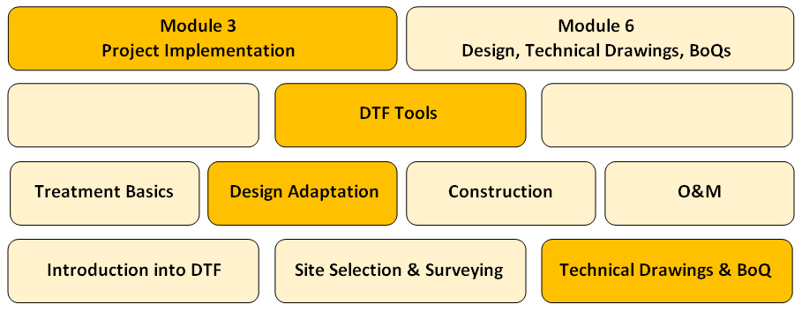
What is the context of this session?
The SafiSan Toolkit
This session

Slide 4
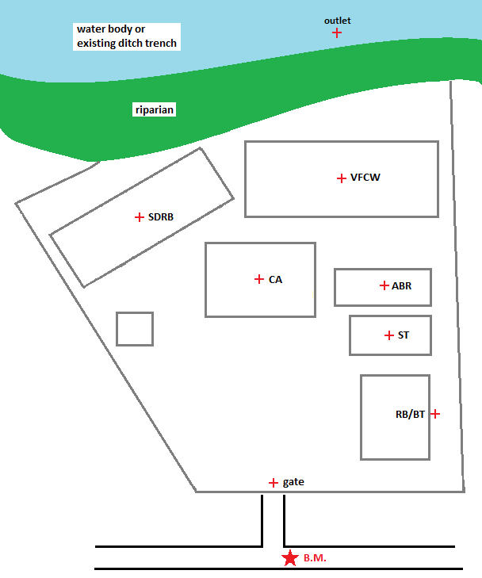
Baseline data collection – Existing levels
Take levels at the following locations (along water flow line):
Level of the final effluent discharge point (flooding level)
Ground levels where different treatment modules will be located (outlets)
Existing ground level where the RB will be located (outlet)
Existing ground level at gate
► To determine in the BoQs the volumes for excavation and refilling (landscaping)

Slide 5
Baseline existing levels: water flow line
VFCW
VFCW
Water Flow line (main treatment line)
Water Flow line (SDRB drainage)
ABR
CA
SDRB
ST
RB/BT
Storage

Slide 6
Baseline - existing levels
1
2
3
Example:
1: 1400.000m (final discharge point)
2: 1400.500m (inspection chamber)
3: 1401.000m (VFCW outlet channel)
4: 1402.000m (ABR/BT outlet pipe)
5: 1403.000m (ST outlet pipe)
6: 1404.000m (RB/BT outlet pipe)
7: 1402.000m (SDRB outlet pipe)
VFCW
VFCW
4
ABR
7
CA
5
SDRB
ST
6
RB/BT
Storage

Slide 7
Design – required minimum levels
1
2
3
Example:
1: 1400.00m (existing flooding level)
2: 1400.20m (Δd=20m, 1% slope)
3: 1400.40m (Δd=20m, 1% slope)
4: 1401.45m (Δh=0.97m within VFCW + Δd=8m, 1% slope in feeding pipe)
5: 1401.52 (Δd=7m, 1% slope)
6: 1402.54 (Δh=1.02m within ABR/BT)
7: 1402.63 (Δd=9m, 1% slope)
8: 1402.73 (Δh=0.10m within ST)
9: 1402.77 (Δd=4m, 1% slope)
10: 1402.58 (Δd=4m, 1% slope, based on ABR inlet)
VFCW
VFCW
4
5
6
10
ABR
CA
7
SDRB
8
ST
9
RB/BT
Storage

Slide 8
Design – cross-section drawing - A
20m, 1%
20m, 1%
1400.40
1400.00
1400.20
Drainage channel

Slide 9
Design – cross-section drawing - A
1401.45
8m, 1%
0.97m
1400.40
Drainage channel
Feeding pipe
Bypass pipe

Slide 10
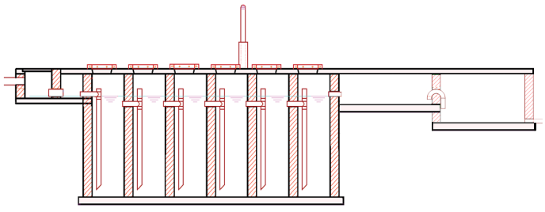
Design – cross-section drawing - A
7m, 1%
1402.54
1.02m
1401.52
1401.45

Slide 11
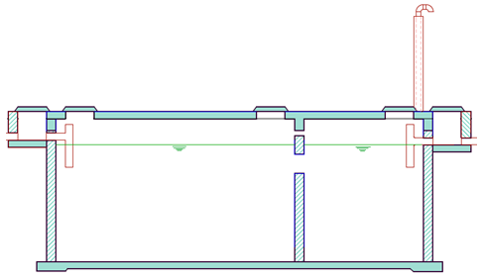
Design – cross-section drawing - A
1402.73
1402.63
1402.54
0.1m
9m, 1%

Slide 12
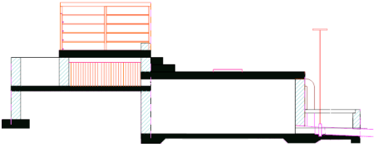
Design – cross-section drawing - A
1402.77
1402.73
4m, 1%

Slide 13
Design – cross-section drawing - A
Total level difference for FS/WW stream: 1402.77-1400.00=2.77m

Slide 14
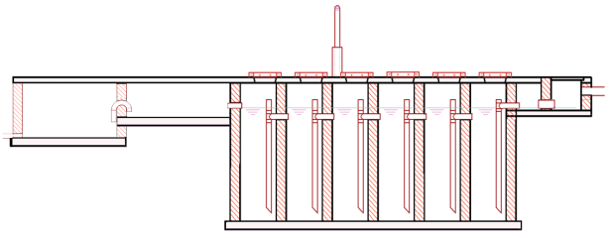
Design – cross-section drawing - B
1402.54
1402.58
4m, 1%

Slide 15
Design – BoQ
The cost for excavation can be calculated based on
The required levels of the modules
The existing ground level
pipe
ST
pipe
ABR
pipe
VFCW
pipe
pipe

Slide 16
Do you have any questions, remarks or suggestions?

